Slide 1


Slide 2
About Today…
Performance Optimization
Caching
Compression

Slide 3

PERFORMANCE
OPTIMIZATION

Slide 4
Intro to Performance Optimization
Definition
Enhancing the speed and efficiency of a web application
Importance
Faster response times, reduced server load, better user experience
Focus
Caching and Compression

Slide 5
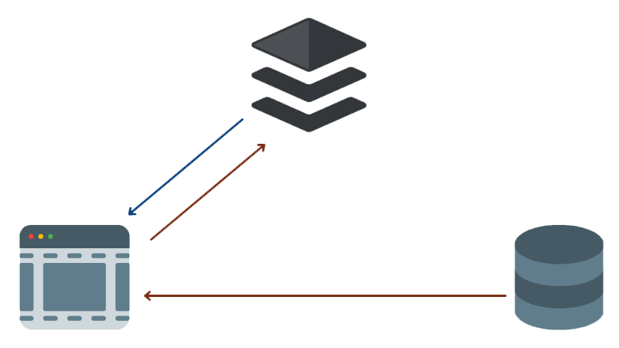
What is Caching?
Definition
Storing copies of files or data to reduce the need to re-fetch or re-compute them
Purpose
Speed up response times and reduce server load
Example
Storing the result of a database query to avoid repeating it

Slide 6

Types of Caching
In-Memory Caching
Storing data in RAM for quick access
File System Caching
Storing data on disk for persistence
Browser Caching
Using HTTP headers to instruct browsers to cache static resources

Slide 7
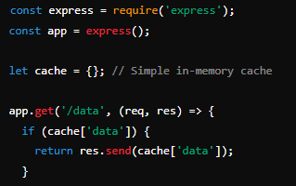
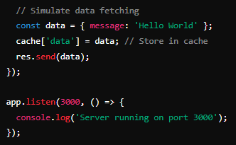
Implementing In-Memory Caching
Concept
Use JavaScript objects to store frequently accessed data
Example Code
Explanation
Stores the response in a JavaScript object to reuse it

Slide 8

What is Compression?
Definition
Reducing the size of data sent from server to client
Purpose
Decreases loading time and bandwidth usage
Example
Compressing a large text file to make it smaller
Benefits of Compression
Reduced File Size
Smaller data transferred over the network
Faster Load Times
Decreases the time to download files
Lower Bandwidth Usage
Saves on data transfer costs

Slide 9
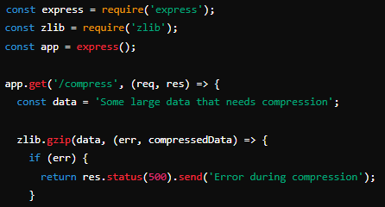
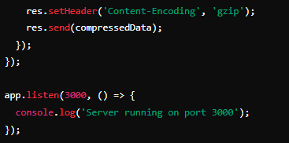
Implementing Compression in Express
Concept
Using built-in zlib module to compress data
Explanation
Compresses data using zlib's gzip method and sets the Content-
Encoding header to gzip.

Slide 10

What is caching in the context of web applications?
Storing data temporarily to speed up future requests
What type of caching stores data in RAM for quick access?
In-Memory Caching
Which header is set to indicate that the content is compressed using gzip?
Content-Encoding
What is the main purpose of data compression in web applications?
Reduce the size of data sent from server to client
Compression and caching can be combined to optimize web application performance
True

Slide 11

Task
Create an Express.js application that implements both caching and compression for an API endpoint

